Slide 1
Office 365 Development
July 2014

Slide 2
Course Agenda
Office 365 Development
Module 1: Getting started with Apps for SharePoint
Module 2: Getting started with Apps for Office
Module 3: Getting started with the Office 365 APIs
Module 4: Moving Full Trust Code to the Cloud Using Repeatable Patterns and Best Practices

Slide 3
Getting started with Apps for Office
Jeremy Thake
Technical Product Manager, Microsoft
Scot Hillier
SharePoint MVP, Scot Hillier Technical Solutions, LLC

Slide 4
Agenda
Intro to the app model
Apps for Office
Getting started
Notes:
What new APIs are available, in preview, in the Office 365 Platform
How to use these API’s in your platform of choice
Some sample business scenarios for leveraging these API’s
Level: Intermediate
Audience: Developer Essentials

Slide 5
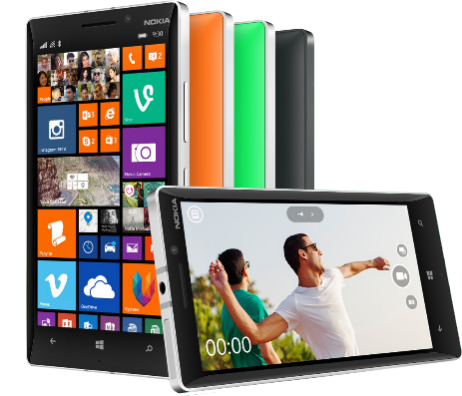


Office 365 development platform
Contextual apps
Robust Office 365 APIs
Flexible tools
Documents
Search
Mail
Social
Calendar
People
Notes:
Two kinds of apps :
you light up Office/Exchange/SharePoint.
You consume our services in a custom (device or web) app
Contextual apps
Rich, powerful interactive IW experiences
Do more, without leaving Excel, Outlook, PowerPoint, SharePoint
Consistent Framework everywhere that Office runs. Everywhere that people do work
Robust APIs
Big news
More for SharePoint Devs
Growing up outside SharePoint
Flexible Tools
Open-ness and choice is a core pillar
But … we just want to take away all the friction
Tools targeted to specific users
Platforms with best management, capability and scale
What does this mean. Where is the value
Breadth : more endpoints and experiences
Depth: richer APIs. More capabilities
Power:

Slide 6
Intro to the app model

Slide 7
Contextual apps
Surface your apps in the Office 365 platform
In context of your business users productivity activities
In Office Client, Office Online, and modern apps

Slide 8
Introducing the app model
SharePoint apps do not “live” on the SharePoint server
Office apps do not “live” on the Office client
Custom code executes in the client, cloud or on-premises
Apps are granted permissions to SharePoint via OAuth
Apps communicate with SharePoint via REST/CSOM
Acquire apps via centralized location
App catalog
Public store (via submission process)
APIs for manual deployment
Notes:
To address many of the challenges developers and site owners had in previous versions of SharePoint, Microsoft has introduced a new development option for SharePoint 2013: The SharePoint App Model.
In this new model apps do not necessary live within SharePoint. Instead the app’s business logic executes within the context of the client (browser) or externally from SharePoint. This external option could be another non-SharePoint Web server or a cloud server. Apps are also more secure in that when they need to access SharePoint resources such as lists and libraries they must be explicitly granted permissions to do so. This is implemented using OAuth. When an app is created, the developer specifies which permission the app needs in order to function. When the app is installed, the user installing the app is prompted to accept the permission requests the app needs (if they deny the permissions, the app is not installed). Once granted permissions, the apps can then talk to SharePoint using the Client Side Object Model (CSOM) or using some of the new OData services in SharePoint.
Developers can build apps and submit them to a marketplace making it easy for customers to acquire these applications.

Slide 9






Modern app development
Apps
Products and platforms
Services and data
Expense
calculator
Vacation
request
Event
planning
Help-desk
support
Learning management
Risk
management
App catalog and store
Notes:
It’s worth spending some time taking you through how we think about modern app development at Microsoft. We have a series of products and platforms like SharePoint and Office that provide a lot of great out-of-the box functionality to help us be productive. To get even more from these products we want to be able to bring information in from other places. Services and data sources like Dynamics, Bing or something that lives out on the web or in the cloud.
With the latest version of SharePoint we’re making it easier to bring together rich web services and data to create powerful new apps. Apps run outside of the SharePoint process, are hosted externally and can be exposed through REST API’s.
Today there are more than 700,000 SharePoint application developers and with this release we’re providing them with a place to surface their apps through an online marketplace of rich partner solutions and applications designed to work with SharePoint and Office.

Slide 10
demo
Adding your first apps

Slide 11
Apps for Office

Slide 12
Office 2013 development scenarios
Web and cross-device ready
Integrate rich web content in Office content
Include contextual content within apps for Office
Pre-Office 2013
Office 2013
Extending Office ribbon
COM add-in
Extending Office ribbon
COM add-in
App for Office
App for SharePoint
Macro
VSTO
Macro
VSTO
Document template
Notes:
Office 2013 will continue to support the extensibility models of previous version of the Office suite. Some of these options included using things like COM Add-Ins, Macros, extensions built using Visual Studio Tools for Office (VSTO) or extending the ribbon. As with any new version, developers are strongly recommended to test these customizations in the latest version of Office 2013.
The new Office 2013 extensibility model that is recommended for developers to leverage when customizing Office 2013 is to build apps. An app is founded on standard Web technologies such as HTML & JavaScript. Because they are founded on web technologies, they can generally be used in both the Office 2013 desktop and web clients. This architecture also means that they are friendly to multiple devices since they are simply executing Web technologies.

Slide 13
Office 2013 development options
Pre-Office 2013 development
Office 2013 desktop apps
Office 2013 web apps
Extending Office ribbon
Task pane app
Content app
COM add-in
Content app
Mail app
Macro
Mail app
VSTO
Notes:
As previously covered, Office 2013 will continue to support the pre-Office 2013 extensibility models including Macros, COM Add-Ins, Ribbon customizations and those customizations built using the Visual Studio Tools for Office (VSTO).
The new model in Office 2013 of building apps includes three different types of apps for Office:
Task Pane: A Task Pane app, available in the Word, Excel & Project Office 2013 desktop clients and the Excel Office 2013 Web client, involves creating a task pane that runs in the left or right margin of the application. This type of extensibility option is a great solution when creating reference or lookup solutions within an application.
Content: A Content app, available in the Excel Office 2013 desktop & web clients, involves adding content to a document. For instance, an Excel workbook could contain a list of stores with their addresses for a sales report. A content app within the workbook could show a map from Bing with pushpins for each of the sales locations.
Mail: A Mail app, available in the Outlook Office 2013 desktop & web clients involves adding additional content based on the context of an item in Outlook. For instance an app could show a map from Bing Maps if it detects a physical address within an email.

Slide 14
Office 2013 development example scenarios
Rich web content
YouTube video and photo gallery
Content authoring
Resumes and contracts
Business processes
Sales and marketing, finance, and HR
Data visualization, analysis and mashups
Maps, custom charts, and lookups
Dashboards
Data analysis and data mashups
Team collaboration
Content and project management
Reference tools
Translation, definitions, dictionary, help, research
Forms and
reports
Legal forms and financial reports
Workflow
Document approval and expenses
Content authoring and publishing
Doc builders and print services
App for Sharepoint
Contextual content and services
Business data lookup (CRM), contextual forms (surveys)
Document template
Document template
Workflow and collaboration
Project tracking, coauthoring
App for Office
App for Office
App for Office
App for Office
App for Office
App for Office
App for Office
App for Office
App for Office
Notes:
Office 2013 introduces a new extensibility option for developers to create custom business solutions. Developers can build an app for Office, new to Office 2013, to enhance the experience when users are working within Office 2013 clients. Unlike previous extensibility models in Office, apps for Office are founded on Web technologies and therefore, depending on the type of app, can be used in both the Office 2013 desktop clients as well as the online clients.
There are three different high-level scenarios that this new model supports. Each builds on the previous scenario:
App for Office: This is the smallest unit of customization. Developers can build one of three types of Apps (Task Pane, Content or Contextual). These can be embedded within an Office application or within an Office document.
Document Template: A document template could consist of multiple apps installed in the template document, or require an app to be installed in the hosting application.
App for SharePoint: SharePoint apps can contain one or more document templates which in turn contain apps for Office.
The slide contains numerous examples of each extensibility scenario.

Slide 15
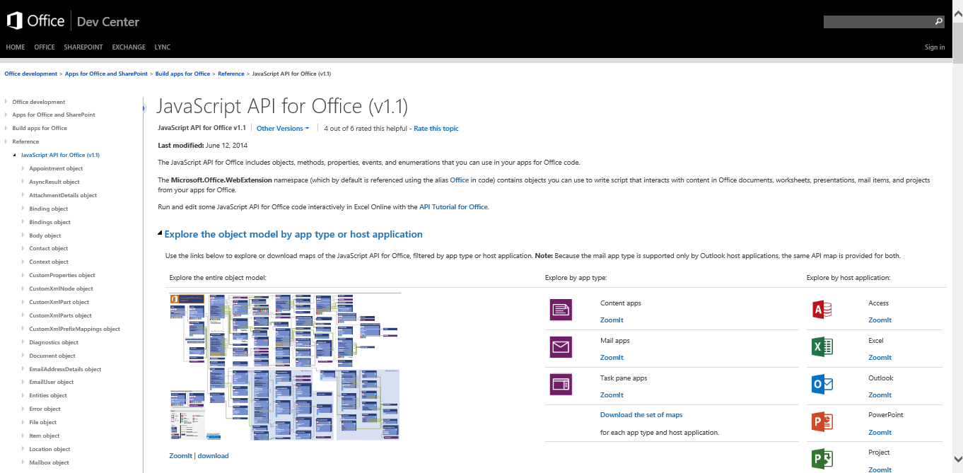
http://aka.ms/OfficeJSAPIs

Slide 16
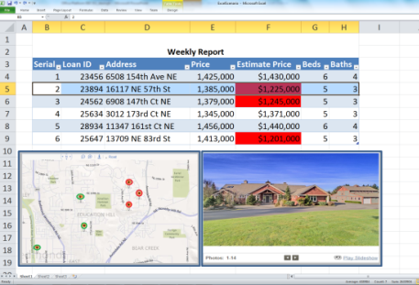

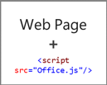
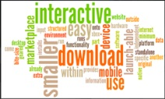
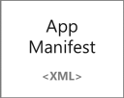
Anatomy of an app for Office
Web server
Office Store or
SharePoint app catalog

Slide 17
App shapes for Office
Task pane
App adjacent to the document
Content
App in the body of the document
Mail Inline pane on an email or appointment item

Slide 18
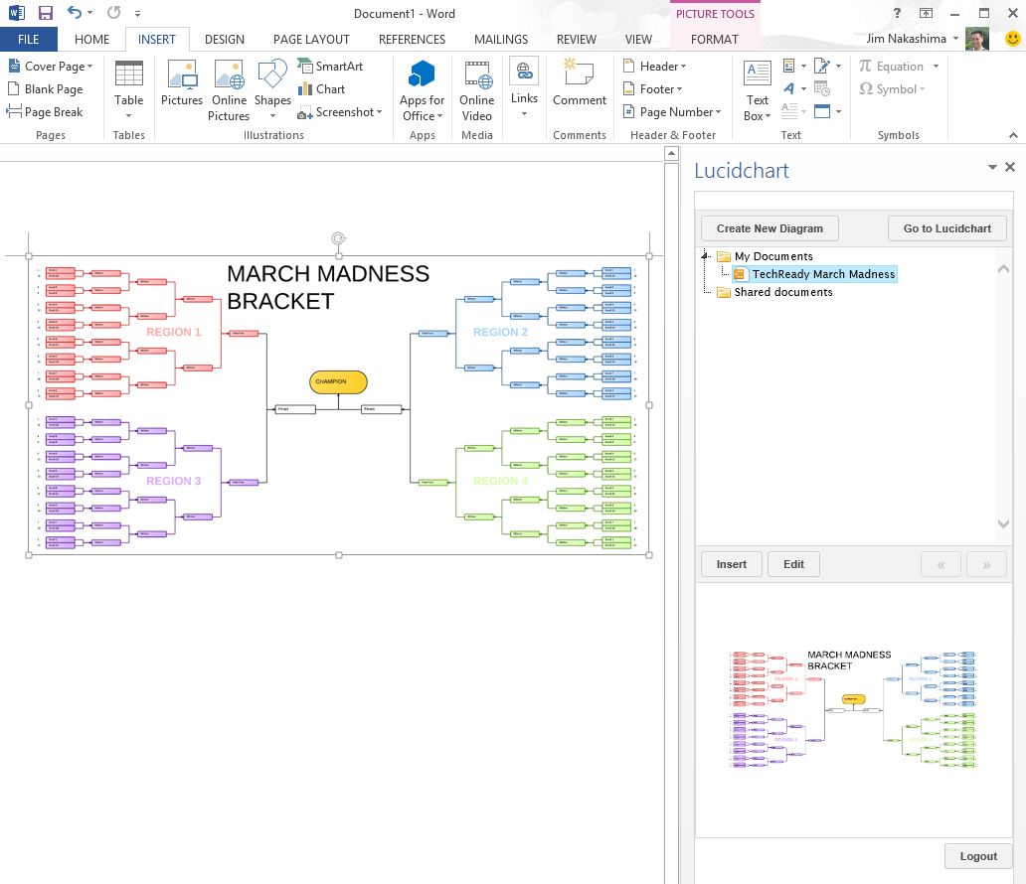
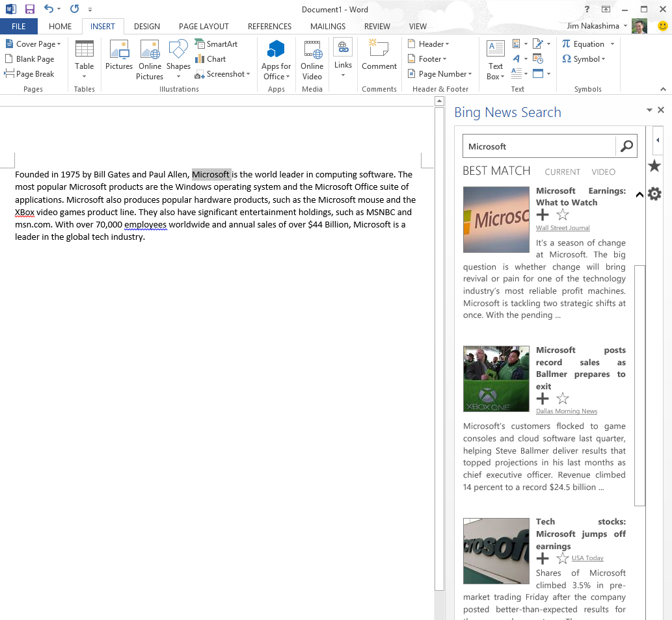
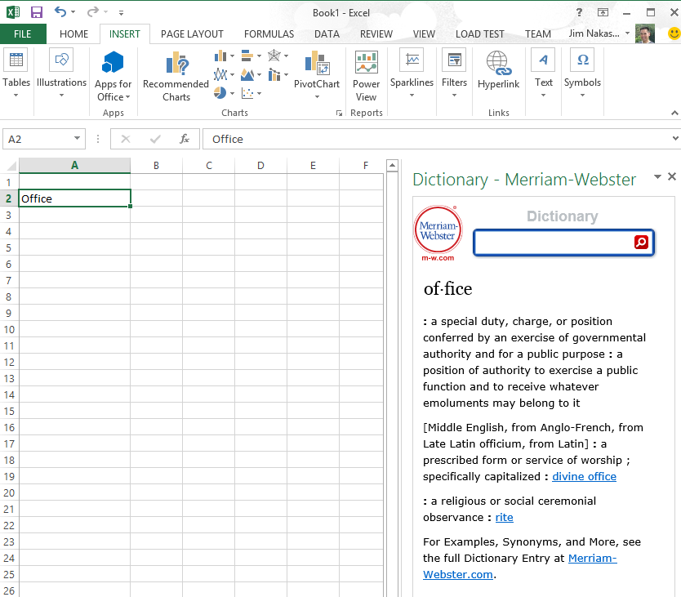

Slide 19
App shapes for Office
Task pane
App adjacent to the document
Content
App in the body of the document
Mail Inline pane on an email or appointment item

Slide 20
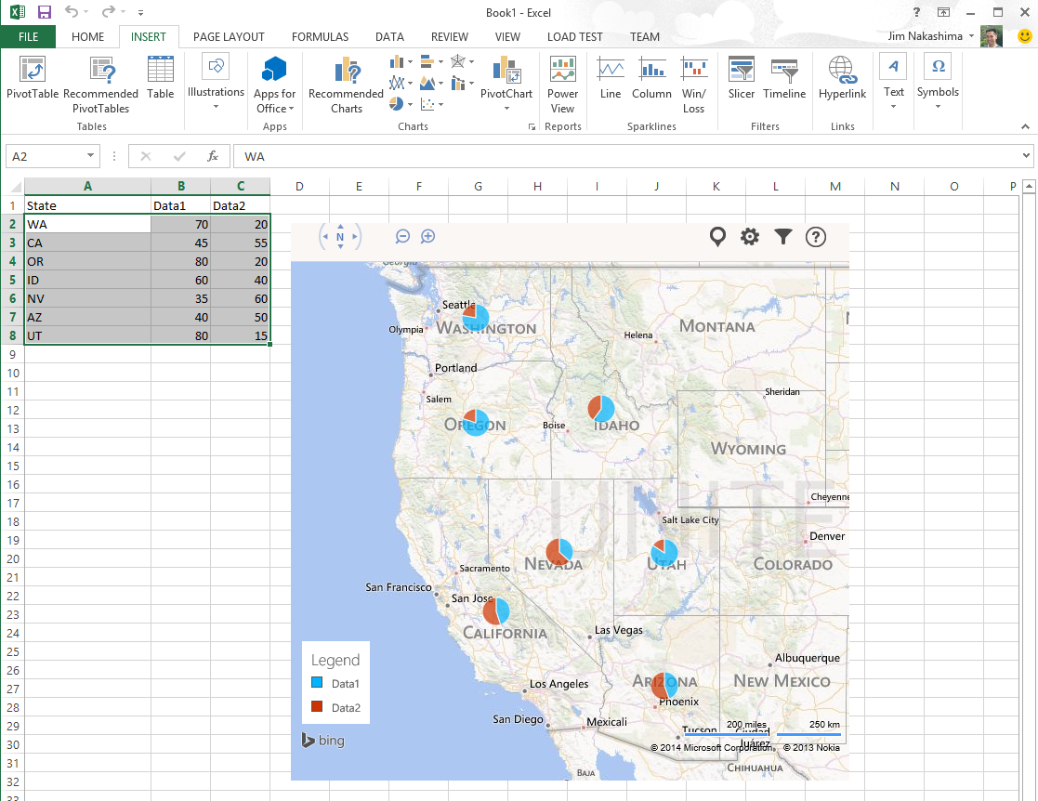
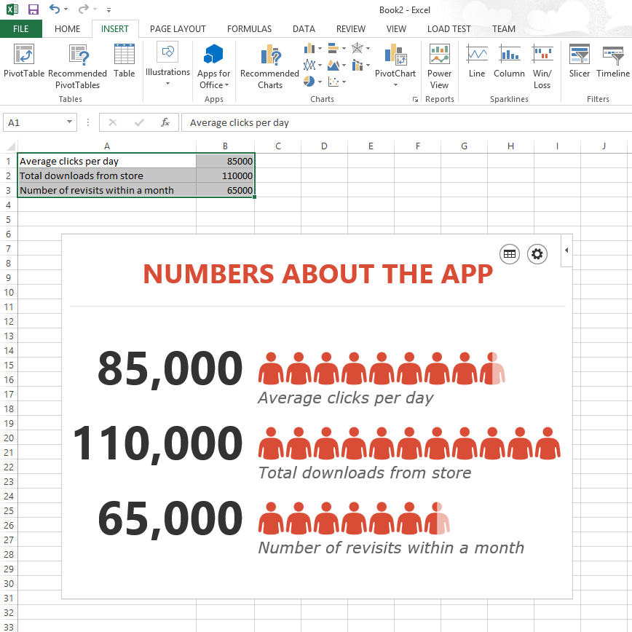
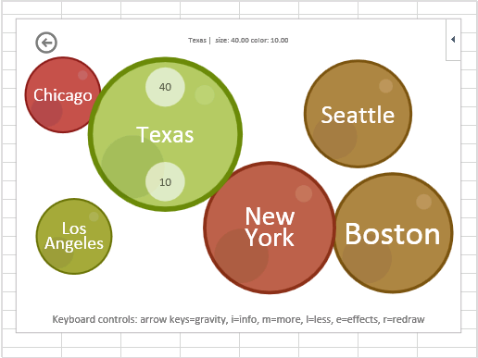

Slide 21
App shapes for Office
Task pane
App adjacent to the document
Content
App in the body of the document
Mail Inline pane on an email or appointment item

Slide 22
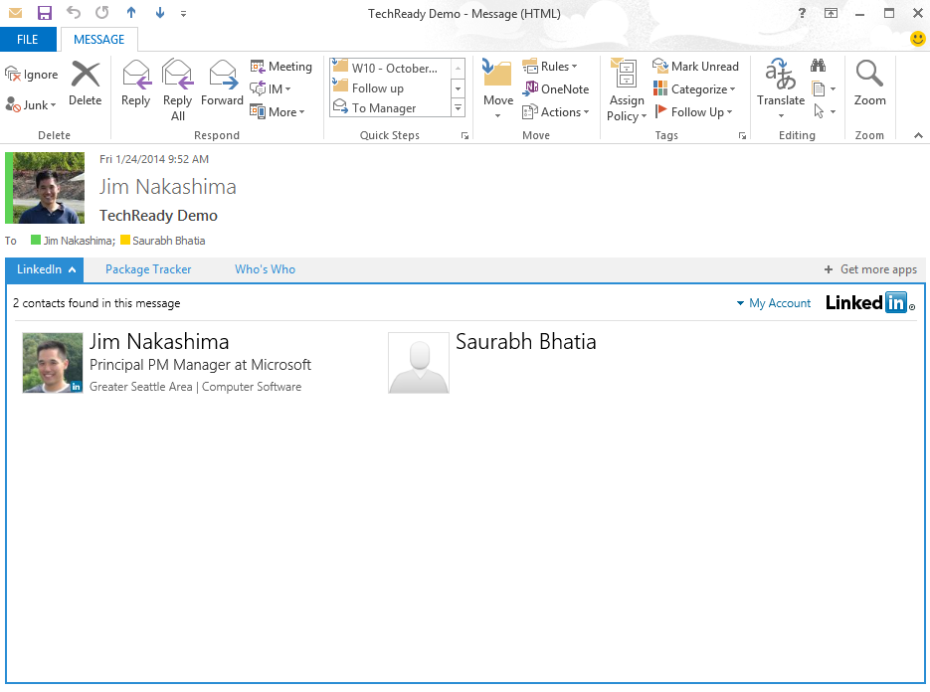
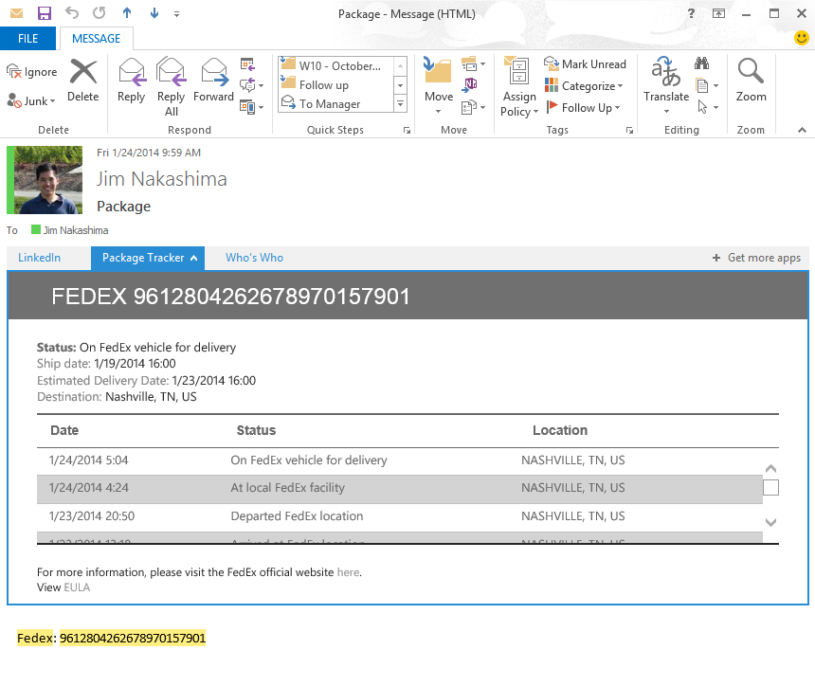
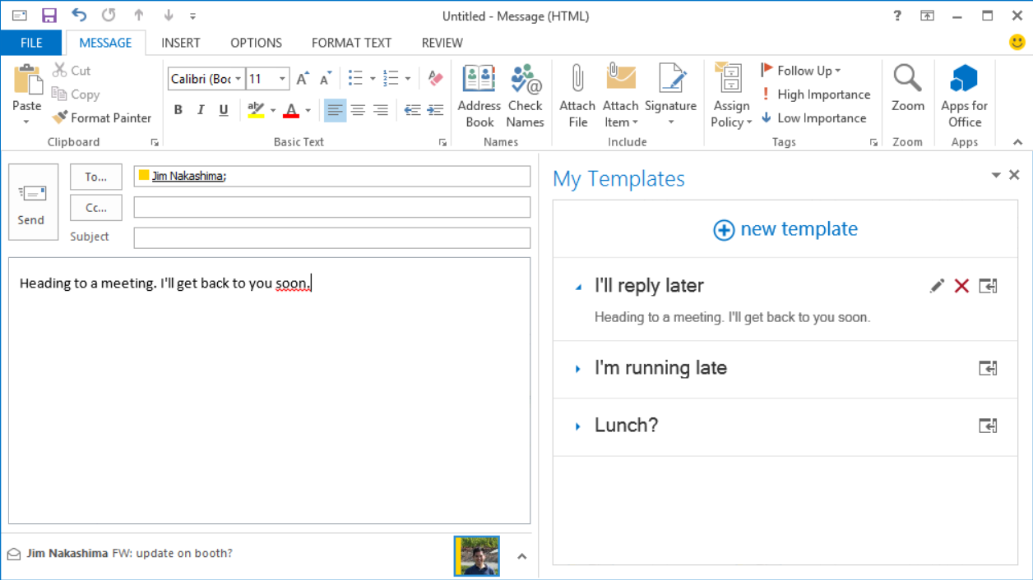

Slide 23
demo
Apps for Office samples

Slide 24
Getting started

Slide 25
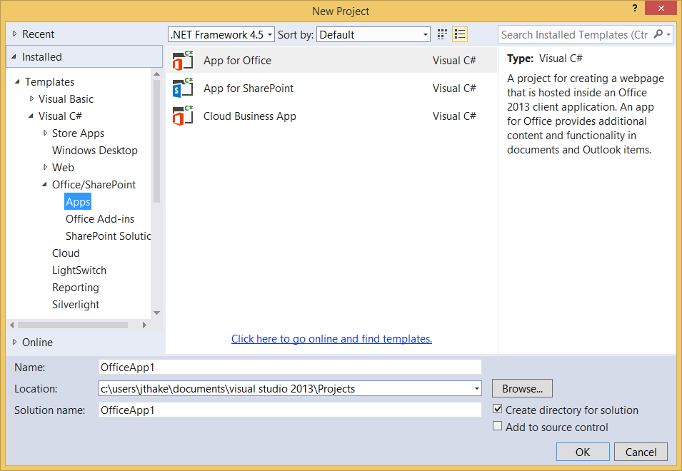
Visual Studio 2013

Slide 26
Environment
Office 365 developer tenant
Office 365 individual developer site collection
On-premises SharePoint server

Slide 27
demo
Building your first app for Office

Slide 28
Conclusion
Surface your business solutions in Office 365 user interface
Leverage the building blocks of the platform
Use the development platform of your choice

Slide 29
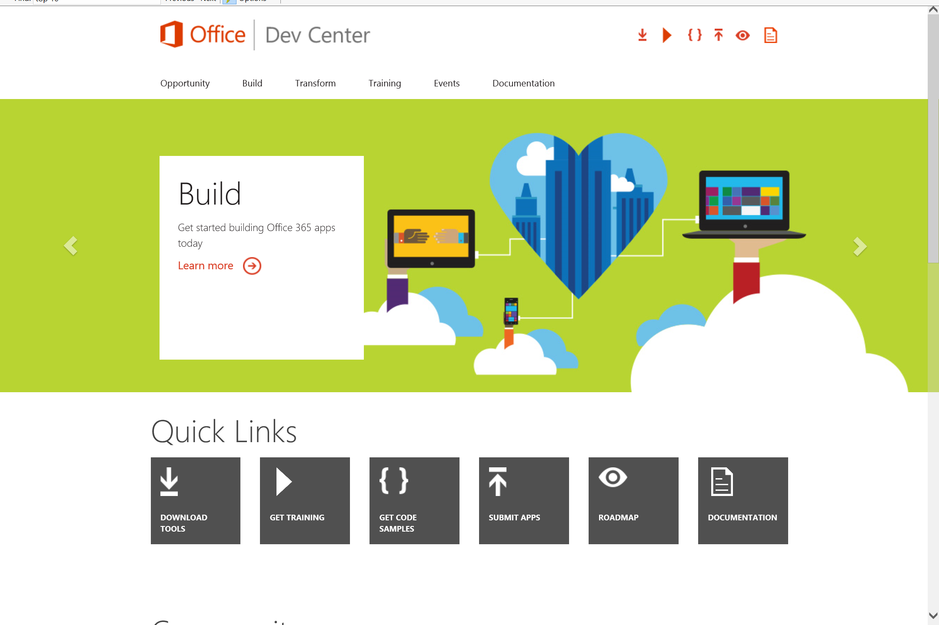
Dev.
Office
.com
One stop shop for Office Developer Platform

Slide 30

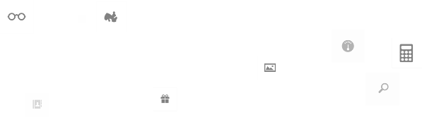
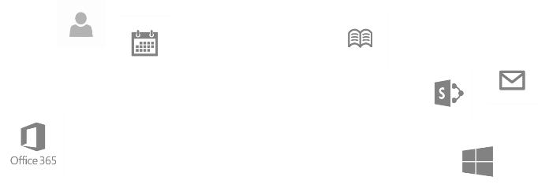
Calls to action
Explore our developer center
http://dev.office.com
Jumpstart into our training http://dev.office.com/training
Play with our code samples http://dev.office.com/code-samples
Get answers
http://aka.ms/AskSharePoint
http://aka.ms/AskOffice
Give feedback Drive our roadmap http://aka.ms/OfficeDevFeedback

Slide 31


Transform your code Providing App Model Patterns for common Full Trust Code scenarios
60+ Visual Studio projects Common scenarios
Branding
Site provisioning
Remote event receivers
Large file support
Taxonomy driven navigation
And much more…
Contribute
Open source coming soon!
Developer
Patterns & Practices
aka.ms/OfficeDevPnP

Slide 32
Microsoft Virtual Academy courses
2014
2015
Deep Dive into integrating Office 365 APIs with your mobile device development
Deep dive into the building blocks and services of the SharePoint platform
Deep Dive into integrating Office 365 APIs with your standalone web application development
Introduction to Office 365 Development
Deep Dive into the Office 365 App Model
Deep Dive into Office 365 Development on non-Microsoft Stack
Shipping your Office 365 App to the Office Store
Aug
Sept
Oct
Nov
Dec
Jan
Feb

Slide 33

© 2014 Microsoft Corporation. All rights reserved. Microsoft, Windows, and other product names are or may be registered trademarks and/or trademarks in the U.S. and/or other countries.
The information herein is for informational purposes only and represents the current view of Microsoft Corporation as of the date of this presentation. Because Microsoft must respond to changing market conditions, it should not be interpreted to be a commitment on the part of Microsoft, and Microsoft cannot guarantee the accuracy of any information provided after the date of this presentation. MICROSOFT MAKES NO WARRANTIES, EXPRESS, IMPLIED OR STATUTORY, AS TO THE INFORMATION IN THIS PRESENTATION.

